Slide 1
Data Science for the Public Good Discussion & Coding
2019 Midwest Big Data Summer School
Aaron D. Schroeder, PhD
Social Decision Analytics Division
Bioinformatics Institute, University of Virginia

Slide 2





We study policy-focused problems
Local / State Government
Arlington County, Virginia
Fairfax County, Virginia
State Higher Education Council of Virginia
Virginia Department of Emergency Management
Federal Statistical Agencies
U.S. Census Bureau
Housing and Urban Development
National Science Foundation
National Center for Science & Engineering Statistics
Department of Defense
U.S. Army Research Institute
Defense Manpower Data Center
Minerva Research Initiative
Industry
MITRE Corporation
Procter & Gamble
Notes:
OPPs = case studies
Local / State Government: Community-based research – democratization of data across the US
Locating and characterizing population, forecasting future needs, evaluating polices and interventions
Small area estimation and changing geographies
Federal Statistical Agencies: Provide timelier data, Offer more geographical detail
Find solutions to declining response rates
Can non-federally (non-survey) collected data be used to enhance or ever replace federal collections
Social, demographic, and economic analyses
National indicators for hard things – innovation, stem pathways, oss
Department of Defense: Combining DoD administrative data with civilian, federally, and non-federally collected data sources
Data enclave asses for non-DoD researchers
Demonstrate value in data to capture much more context – Soldier, team, unit, organization, culture, etc.
Industry: Penetrate data silos
Supply chain synchronization using business transactional data
Information flows for electronic health record eco-systems (VA)

Slide 3
SDAD Web Page

Slide 4
Our Data Science Framework
Keller, S.A., S. Shipp, G. Korkmaz, E. Molfino, J. Goldstein, V. Lancaster, B. Pires, D. Higdon, D. Chen, and A. Schroeder. 2018. "Harnessing the Power of Data to Support Community-Based Research." WIREs Computational Statistics. e1426.
Keller, S.A., G. Korkmaz, M. Orr, A. Schroeder, S. Shipp. 2017. "The Evolution of Data Quality: Understanding the Transdisciplinary Origins of Data Quality Concepts and Approaches." Annual Review of Statistics and Its Applications 2017. 4:5.1-5.24.

Slide 5
Continuous Process of Engagment
S. Keller, V. Lancaster, S. Shipp. (2017). Building Capacity for Data-Driven Governance: Creating a New Foundation for Democracy. Statistics and Public Policy, September.

Slide 6
Observations from Our Work Thus Far
Issues that have arisen and repeat from our community engagements thus far:
Locating and describing a population within a community
Estimating a statistic and a measure of its variability to evaluate its usefulness for the purpose at hand
Forecasting future needs
Evaluating a program, policy, or standard operating procedure
Research challenges that are emerging through our work:
Formalization and automation of Data Science Framework
Data integration, analysis, and linkage across multiple levels of data support
Data and corresponding estimation redistribution across multiple geographies
Composite indices development and alignment with issues

Slide 7
Data Science for the Public Good (DSPG)
Experiential learning program through which participants learn everything they need to know to get started working as a data scientist in policy-oriented positions
Creating Public Good-Oriented Data Scientists, or “Policy Scientists”
Learning not just how to do the work, but also how to work across disciplines on problem-solving teams
For the graduate fellows, also learning how to run these teams, managing both up an down
All started when asked to teach ”Research Methods” for Masters of Public Administration students

Slide 8















Data Science for the Public Good (DSPG)
DSPG 2018 fellows, undergraduate students, and alumni during the DSPG Symposium at Virginia Tech Research Center in Arlington.

Slide 9
DSPG Experience Goals
Work on truly multi-disciplinary project teams comprising diverse levels of experience (students, post-docs, researchers, and federal leaders) and a broad range of academic perspectives (data science, statistics, economics, sociology, psychology, geography, and others)
Engage in meaningful research focused on real-world problems and addresses social policy
Work in partnership with government sponsors and policy makers
Learn the entire Data Science for Policy process, from stakeholder engagement and problem definition to the delivery of policy impacting analyses, tools and data products
Directly interact with policy leaders and government agencies through field trips and regular policy events on Capitol Hill and the surrounding area
Learn essential tools for scientific and statistical computing, including R, Python, Databases, GIS, and other software tools as needed for projects
Engage with leading policy practitioners and researchers through SDAD’s Visiting Scholar program, which includes economists, statisticians, and other social science researchers with diverse public and private sector experience

Slide 10


DSPG Annual Symposium, Speaker Series

Slide 11





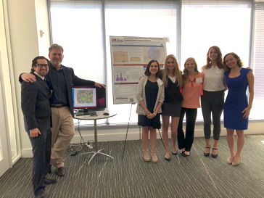



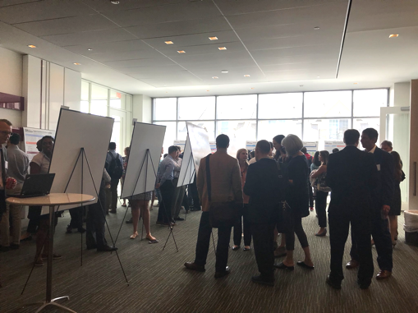


Slide 12
DSPG Syllabus
DSPG 2019 Program Schedule

Slide 13
Projects - WMATA
Problem: WMATA loses approximately 10-20 million dollars a year due to bus fare evasion on its 1300-1500 daily trips
Research Goal: Provide insights into the problem of bus fare evasion that can be used to guide fare
evasion interventions
Analysis Plan: Using WMATA administrative data locate where fare evaders live and American Community Survey
to tell their story at the census
block group level

Slide 14
General Observations about Fare Evasion
Widespread national and international problem
Typically estimated using observer surveys and not using administrative data
Observer surveys include: high costs, missed assignments, difficulty processing large passenger volumes, data interpretation issues, data entry and analysis costs, and potential data collection inconsistencies between observers
The fare evasion estimates from surveys do not include an estimate of the variability

Slide 15
WMATA Administrative Data Sources
Data Sources for the first week of May (5/1 – 5/7/2017)
Bus Stops (10,988 observations): Contains the stop ID, stop name, latitude, and longitude
Automated Person Counter (APC): Contains front & back door entries and exits for a bus, route, trip number and bus stop
Farebox: Contains cash & SmarTrip transactions for a bus, trip number, & bus stop
Data Issues: Imprecise latitude and longitude coordinates, missing or mislabeled bus routes and stop IDs in Farebox and APC data, missing trip numbers in Farebox data

Slide 16
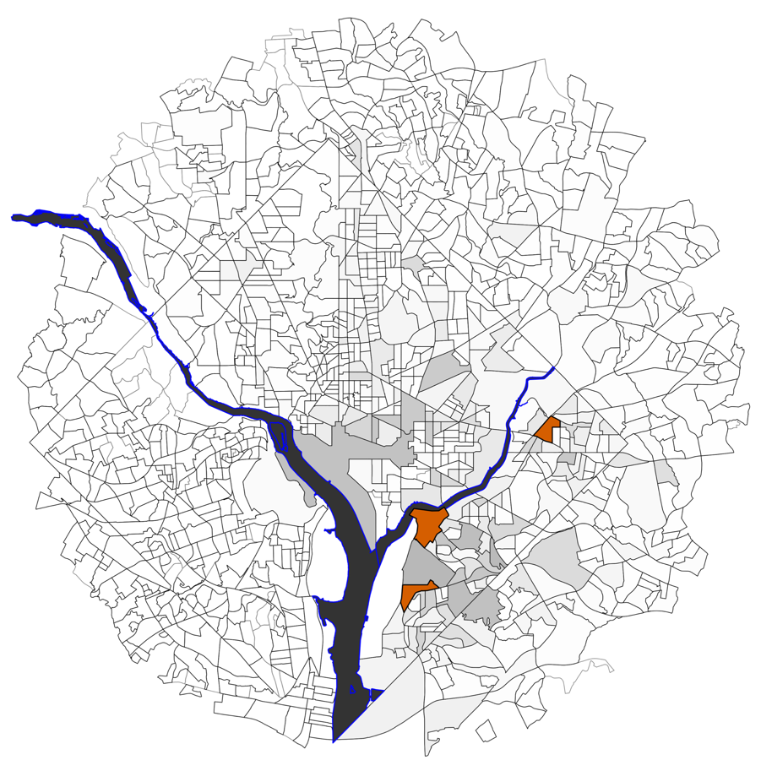
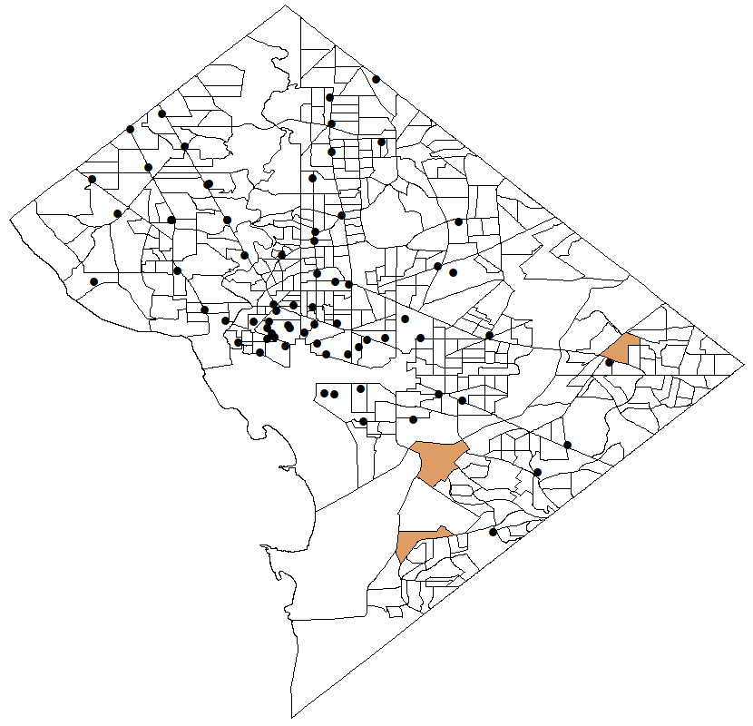
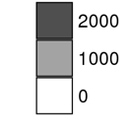
Fare Evasion in Evenings 2-8 pm
Locations to add money to SmartTrip cards in DC
Could this contribute to fare evasion?

Slide 17
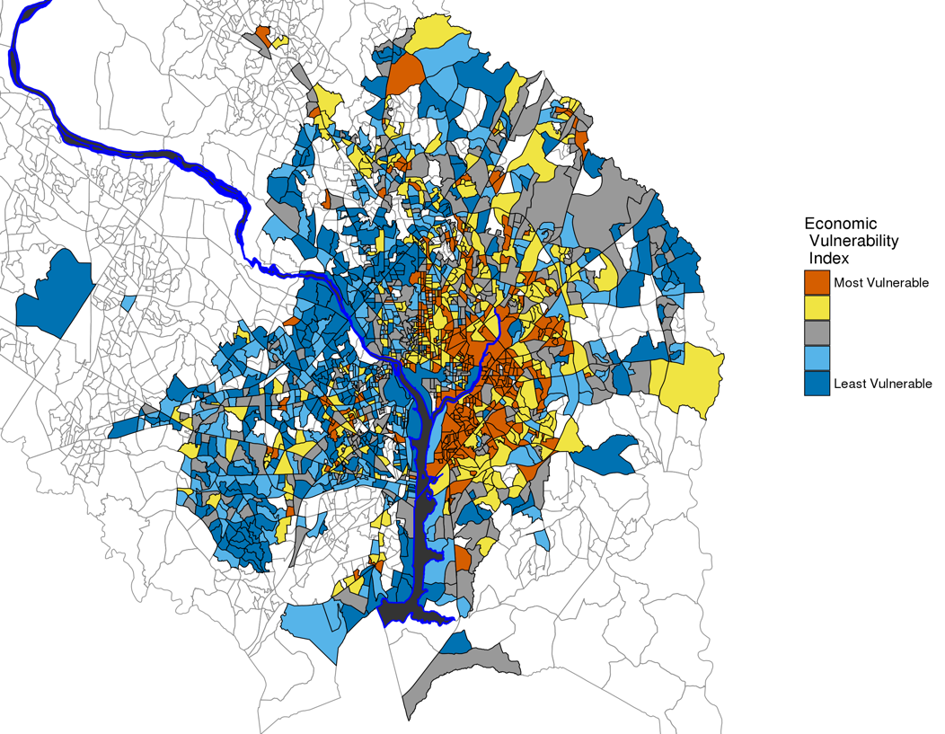

Economic Vulnerability Index
Composite economic vulnerability index by census block groups with bus stops in the seven WMATA jurisdictions
The composite index was constructed using ACS (2015) variables:
% households in poverty (Federal)
% households with no vehicle
% households qualifying for SNAP
% households with housing burden > 50%

Slide 18
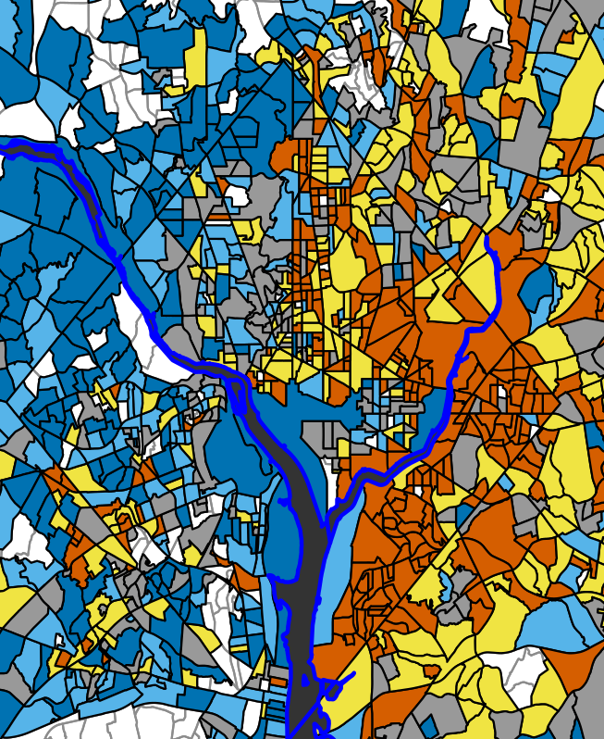
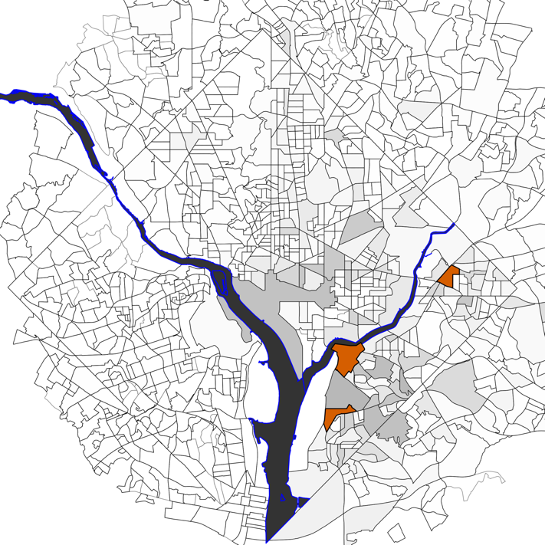
Insights for Potential Interventions
Not all economically vulnerable Census Block Groups have high numbers of fare evaders, but all Census Block Groups with a high numbers of fare evaders are economically vulnerable.

Slide 19
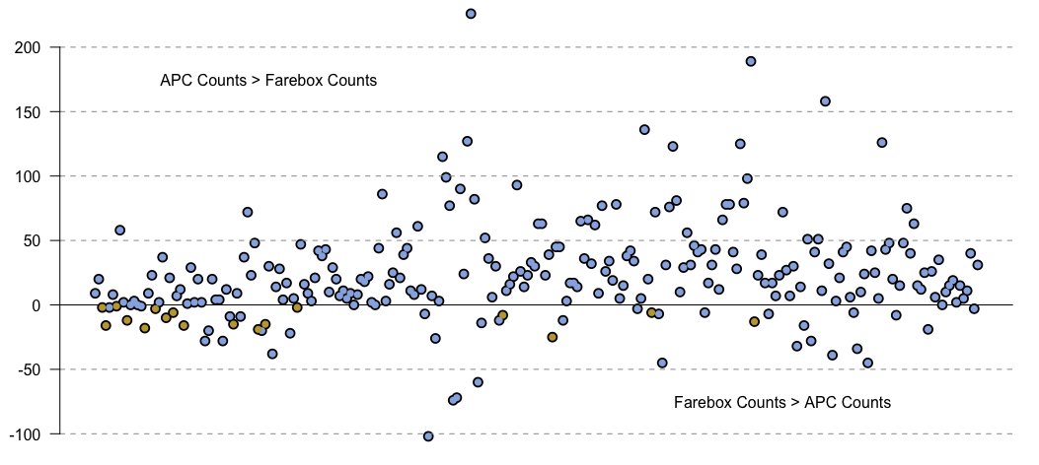
Cautionary Tale: Need Accurate Estimates for Policy Implementation and Evaluation
To test hypotheses or experiments for interventions, need to know how accurately fare evasion can be estimated – what effect sizes can be measured!
APC Counts > Farebox Counts
APC – Farebox Counts
APC Counts < Farebox Counts
Orange circles = zero APC counts
Aggregates by Bus ID for May 1st – May 5th
Notes:
For descriptive I can start with WMATA and cast it as exploratory and demonstrate how it has helped generate hypotheses - culture of doing the right thing and affordability - I can discuss how you would want to set up data collection to be able to actually test these “constructs” and will use interventions to do it. I can then launch into a discussion of measurement accuracy and what we would want to do there - goes along with the notion of power calculations in experimental design.
Also want to mention evaluating explanatory models, e.g., R2 type measure
This example will also give me the opportunity to talk about observational data and potential biases if used in a predictive model, how you would want to be sure to understand and control for these in the testing of the constructs.

Slide 20
So Much Learning!

Slide 21
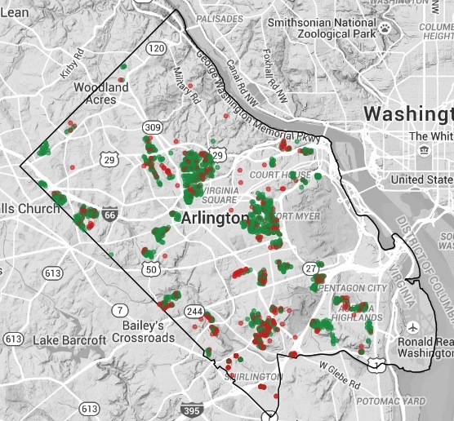
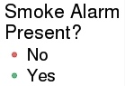
Projects – Operation FireSafe
Issue: Fire Department wants to improve the efficiency of their Operation FireSafe program
Out of 5,623 visits to single family homes only 1,799 had an adequate number of working smoke detectors
Goal: Construct models to predict for each single family home the probability it has adequate smoke detectors

Slide 22
The DATA
Household Level (Administrative Data): Operation FireSafe data for the 5,623 single family homes visited
Household Level (Administrative Data): Real estate tax assessments for 60,343 single family homes including tenure, home age, value, size, and number of bedrooms
Household Level (Opportunity Data): Geocoded the single family home locations
Census Tract Block Group Level (Designed Data):
5-year 2015 American Community Survey – household level demographic and socioeconomic data

Slide 23
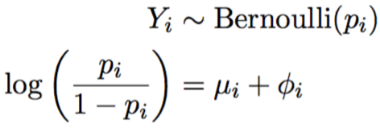
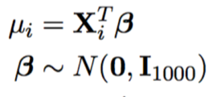
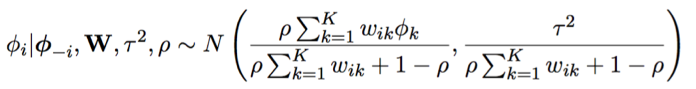
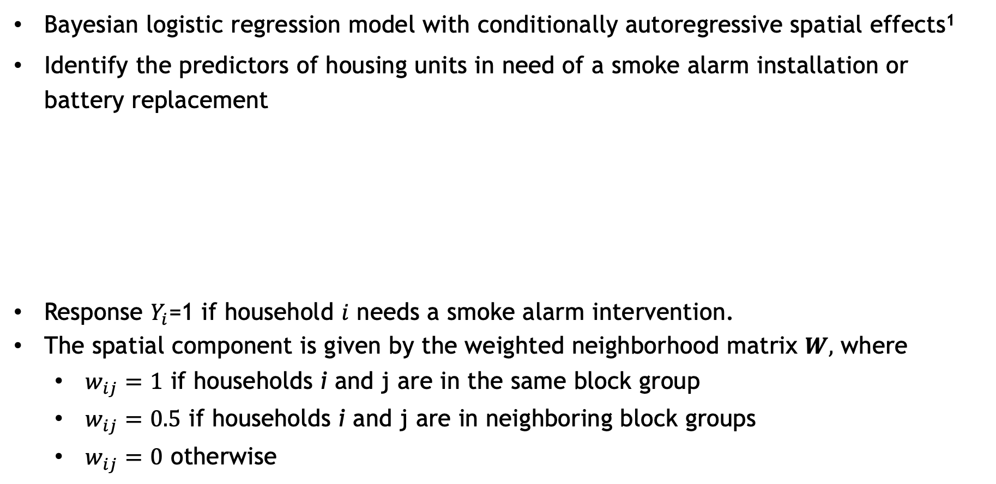
Model to Predict Regions in the County in Need of Smoke Alarms
Bayesian logistic regression model with conditionally autoregressive spatial effects¹
Identify the predictors of housing units in need of a smoke alarm installation or battery replacement
Response $Y_{i}$=1 if household $i$ needs a smoke alarm intervention.
The spatial component is given by the weighted neighborhood matrix $W,$ where
$w_{ij}=1$ if households i and j are in the same block group
$w_{ij}=0.5$ if households i and j are in neighboring block groups
$w_{ij}=0$ otherwise
¹Leroux B, Lei X, Breslow N (1999). Estimation of disease rates in small areas: a new mixed model for spatial dependence. Statistical Models in Epidemiology, the Environment and Clinical Trials. Springer-Verlag: New York.

Slide 24
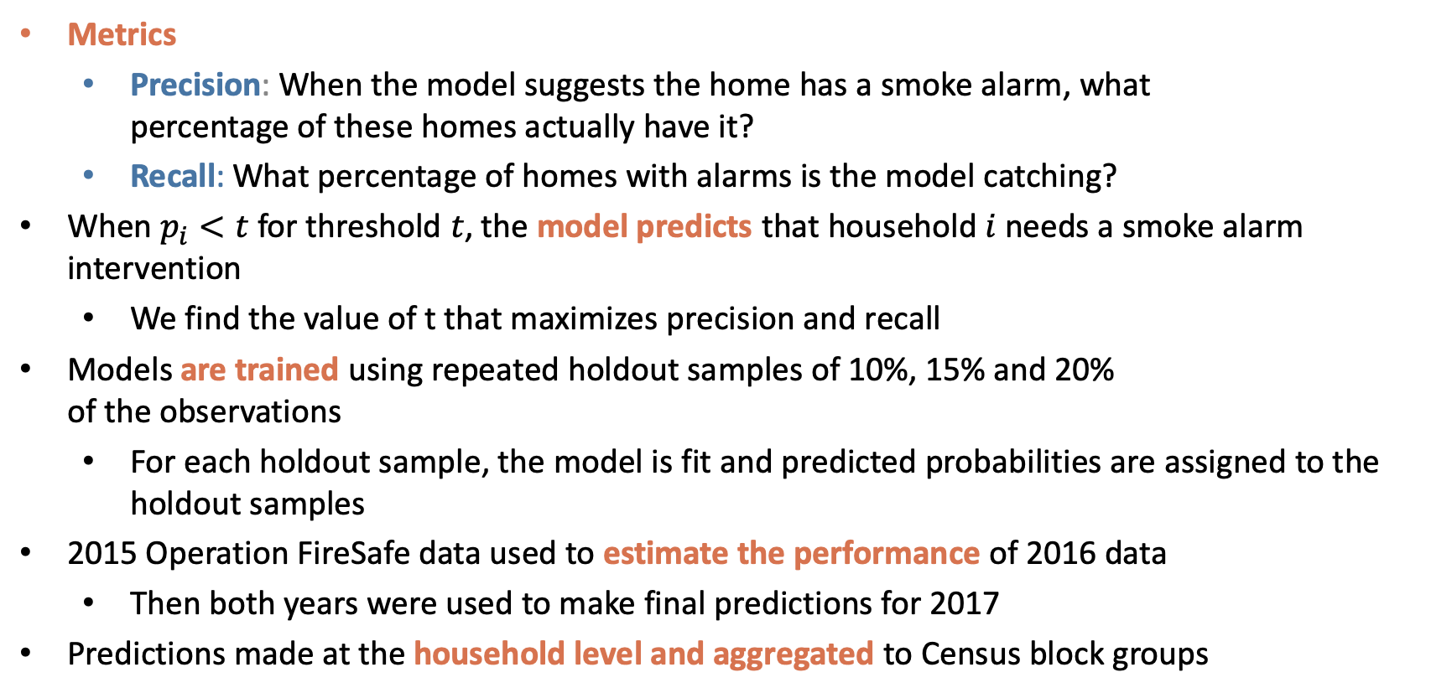
Evaluating Predictive Performance
Metrics
Precision: When the model suggests the home has a smoke alarm, what percentage of these homes actually have it?
Recall: What percentage of homes with alarms is the model catching?
When $p_{i}<t$ for threshold $t$, the model predicts that household $i$ needs a smoke alarm intervention
We find the value of t that maximizes precision and recall
Models are trained using repeated holdout samples of 10%, 15% and 20% of the observations
For each holdout sample, the model is fit and predicted probabilities are assigned to the holdout samples
2015 Operation FireSafe data used to estimate the performance of 2016 data
Then both years were used to make final predictions for 2017
Predictions made at the household level and aggregated to Census block groups

Slide 25
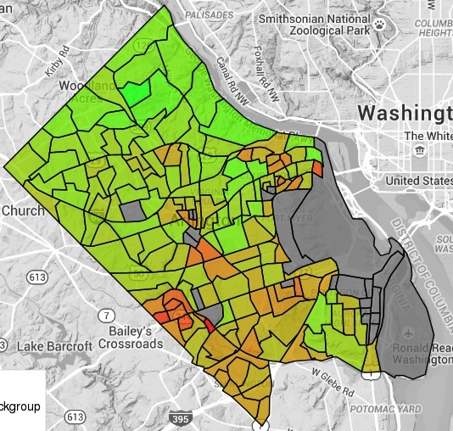
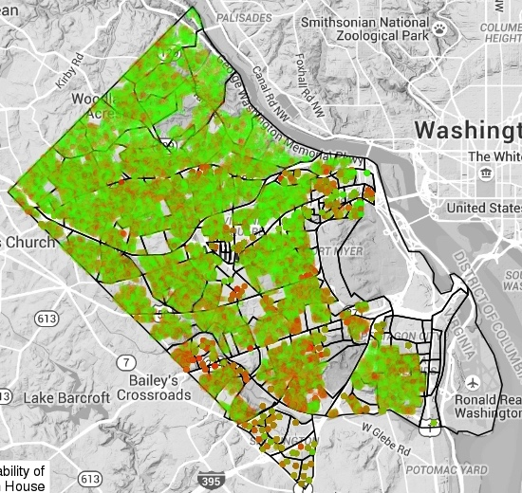
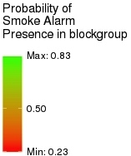
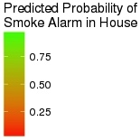
Probability of Having a Smoke Alarm
Bayesian logistic regression model with conditionally autoregressive spatial effects
Census Block Level Predictions
Housing Unit Level Predictions
Notes:
The model estimates the probability that a housing unit has a smoke alarm.
We fit a Bayesian logistic regression model with conditionally autoregressive spatial effects.
Because of the spatial dependence included in the model, the predictions are made for each residential unit in the CoreLogic data source that are:
in census block groups that appeared in the original data or in a census block group neighboring those in the original data; and
with no missing covariate values and/or census block group information.
Predictions are made for 49,178 residential units.

Slide 26
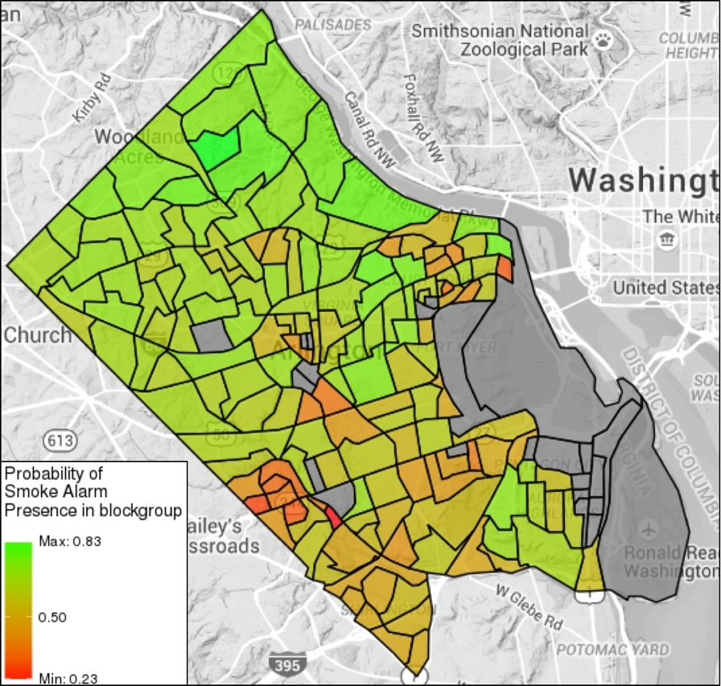
Findings
Predictors of smoke detector need
At the household level:
Home value (-)
Age of home (+)
At the neighborhood level:
Median income (-)
Percent living alone (+)
Percent family households (-)
ACFD used a list of vulnerable neighborhoods predicted to target their visits for 2017

Slide 27
Projects – Arlington Restaurant Initiative Measuring the Impact of Alcohol-Related Crime Reduction Strategies for Restaurants and Nightlife in Arlington
Arlington County features some of the most unique restaurants and nightlife destinations in the Washington D.C. metro region. Areas such as Clarendon, however, with a large number of restaurants have become a difficult issue for police to manage due to alcohol-related crimes such as malicious wounding, sexual assault, public intoxication, assault on police, DUI, disorderly conduct, and rape.

Slide 28
Projects – Arlington Restaurant Initiative Measuring the Impact of Alcohol-Related Crime Reduction Strategies for Restaurants and Nightlife in Arlington
Arlington County Police Department (ACPD) launched the Arlington Restaurant Initiative (ARI) that focuses on best practices for restaurants and nightlife to reduce the risk of alcohol-related disorder. The initiative grew out of the Clarendon Detail, the creation of a team of patrol officers using overtime to control pedestrian and road traffic, and to ensure that intoxicated patrons are protected from harm.

Slide 29
Projects – Arlington Restaurant Initiative Measuring the Impact of Alcohol-Related Crime Reduction Strategies for Restaurants and Nightlife in Arlington
Objective: Evaluate effectiveness (social and economic impact) of ARI in Clarendon to help ACPD sustain and support program funding.
Need a justifiable funding model that goes beyond counting arrest

Slide 30
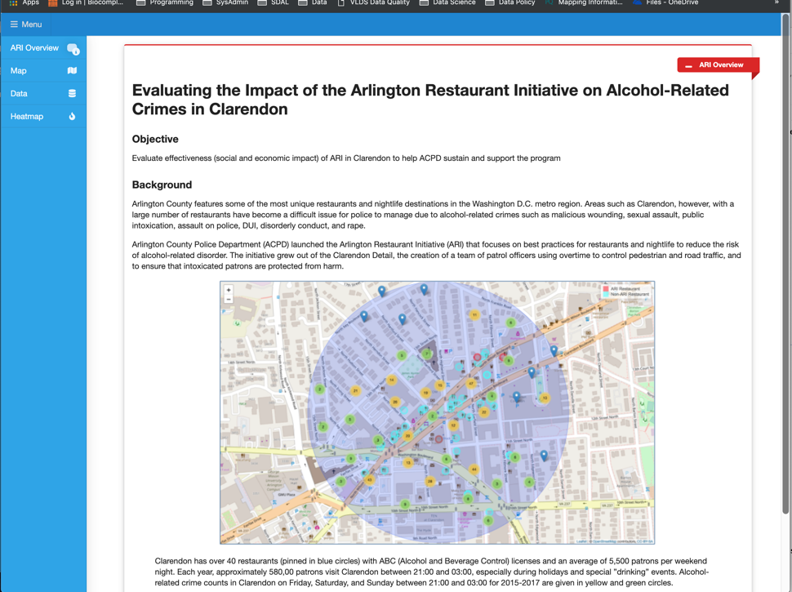
Projects – Arlington Restaurant Initiative

Slide 31
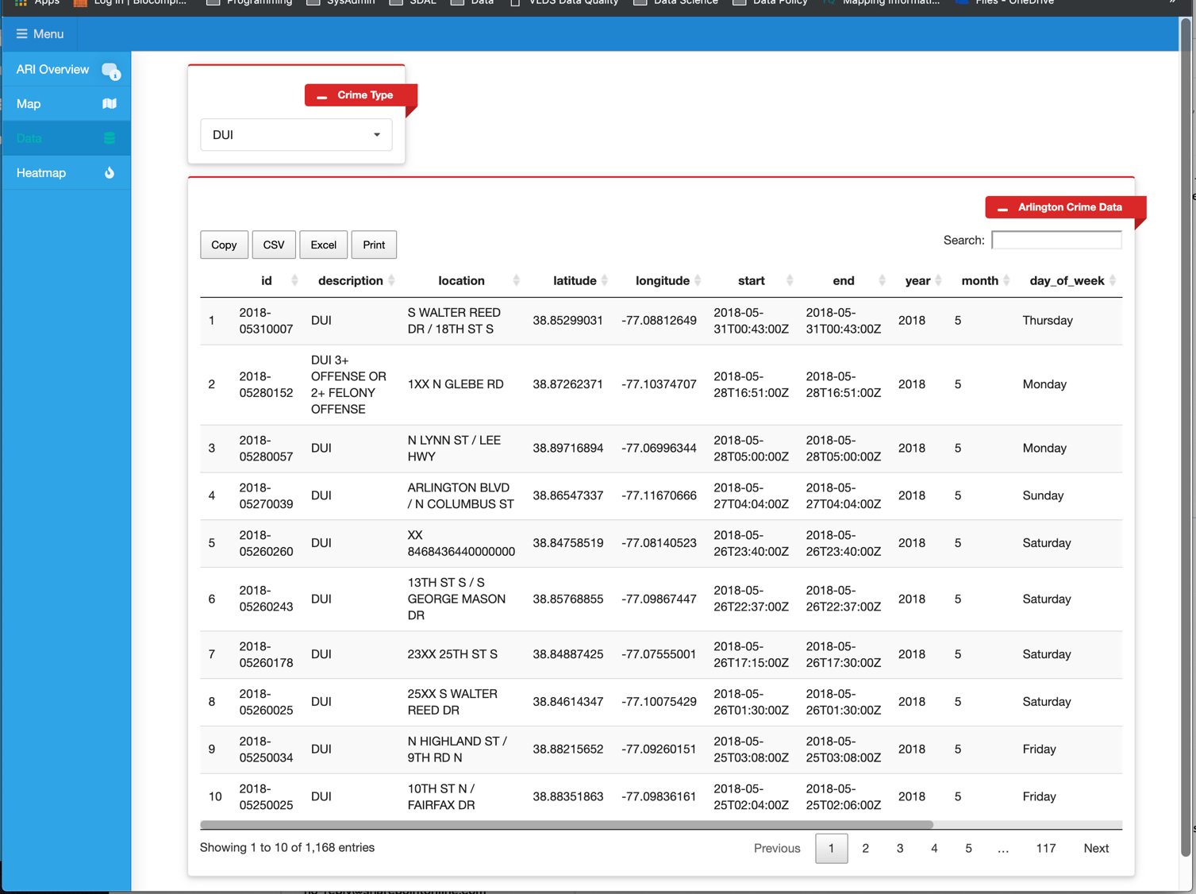

Slide 32
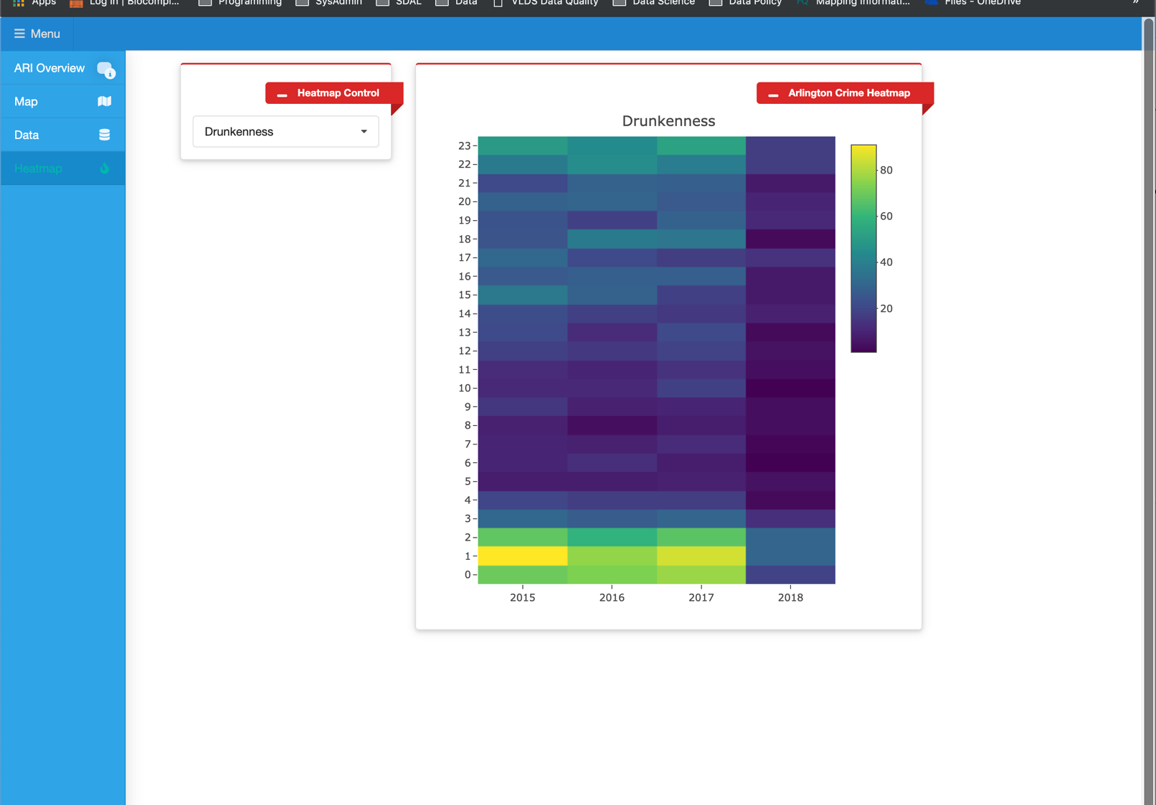

Slide 33
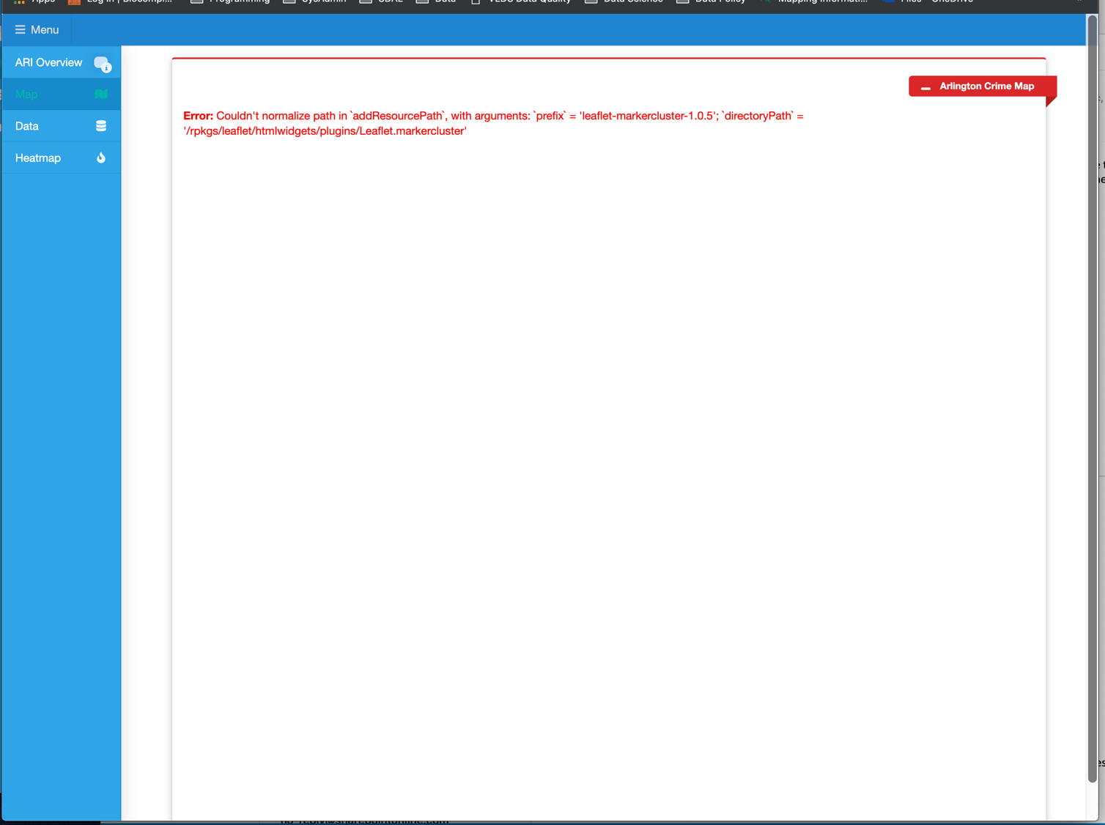
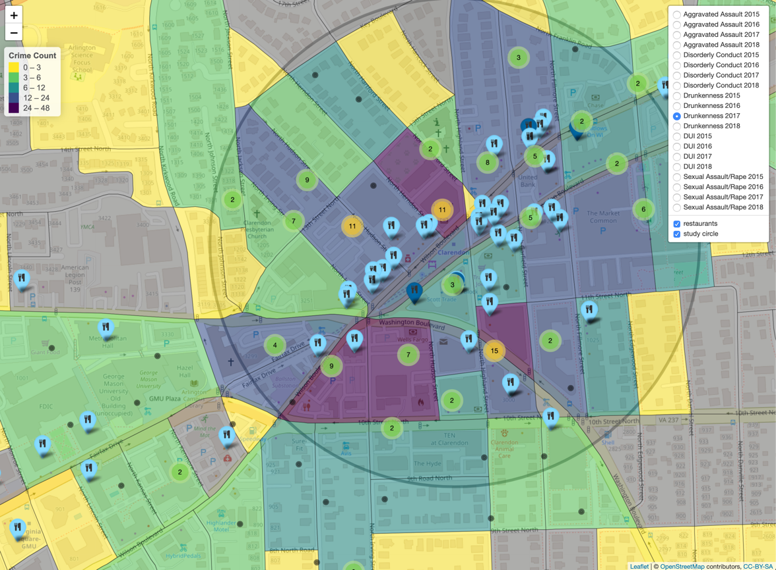

Slide 34
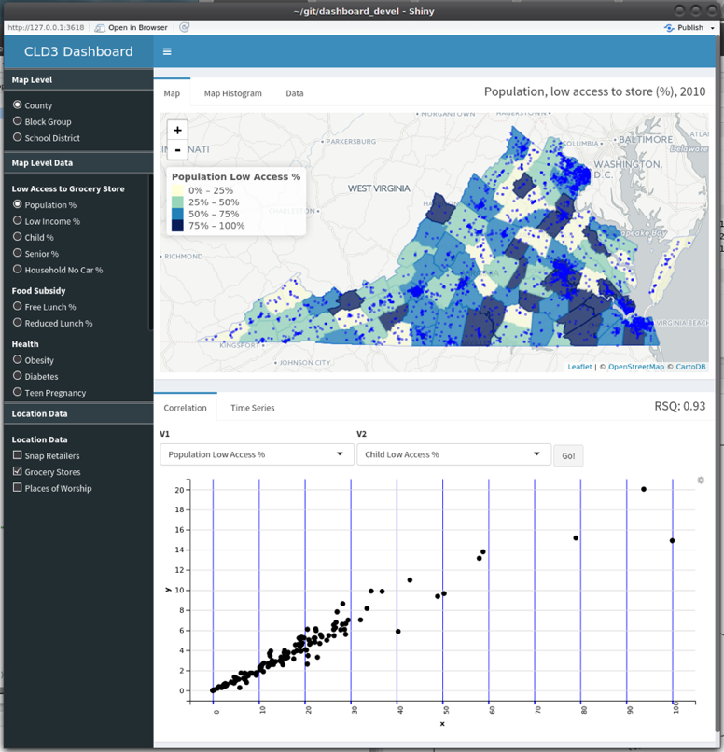
New Data Sources for VCE Community Profiles
Project Background
VCE District Planning includes an process of Community Profiling
SDAL is currently working with VCE to develop a Dashboard that will allow for a deeper level of analysis than is currently conducted, including:
Location (Place)-Level Data (Places of Worship, SNAP Providers, Social Service Locations)
Sub-County-Level Data (Block Groups, Water Districts, School Boundaries)
Tools for quick descriptive analysis (Maps, Time-Series, Scatterplots

Slide 35
New Data Sources for VCE Community Profiles
Project Goal(s) / Research Questions
Discover possible sub-county data sources for use by VCE in creating community profiles, including:
Radon Levels
Active Coal Mine Locations
Water Quality (Rivers)
Water Quality (Treatment Plants)
Soil Status Quality
Crop Coverage
Profile discovered data sources quality, structure, provenance and metadata
Determine necessary transformations for data re-purposing and overall data source fitness to support VCE goals
Incorporate new data into dashboard; create new dashboard tools

Slide 36
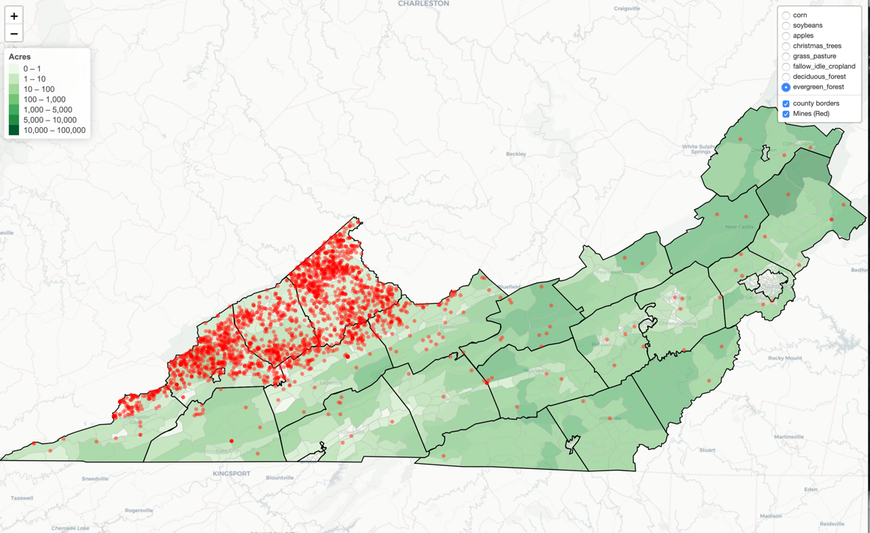
New Data Sources for VCE Community Profiles

Slide 37

Fairfax Youth Partnership Describing Populations and Forecasting Future Needs
Issue: Characterize the factors that describe depression and obesity in youth
Goal: This type of understanding will allow Fairfax County to implement policies targeted to address youth behaviors
Approach: Identify access to food and physical activity options, e.g. grocery stores, restaurants, farmers markets, community gardens, parks, and more

Slide 38
The DATA
Household Level
Geocoded the household locations
Supervisor districts
Places of Interest
Food, parks and recreation centers
Transportation – routes and modalities
Clinics
Census Tract Block Group Level
5-year 2015 American Community Survey – household level measures of economic vulnerability
School Level
Locations and boundaries
Fairfax County Youth Survey, 2010 -2015

Slide 39
Youth Reporting Depressive Symptoms
Percentage of Students Who Felt Sad or Hopeless in the Past Year
Source: Fairfax County Youth Survey, 2010 – 2015

Slide 40
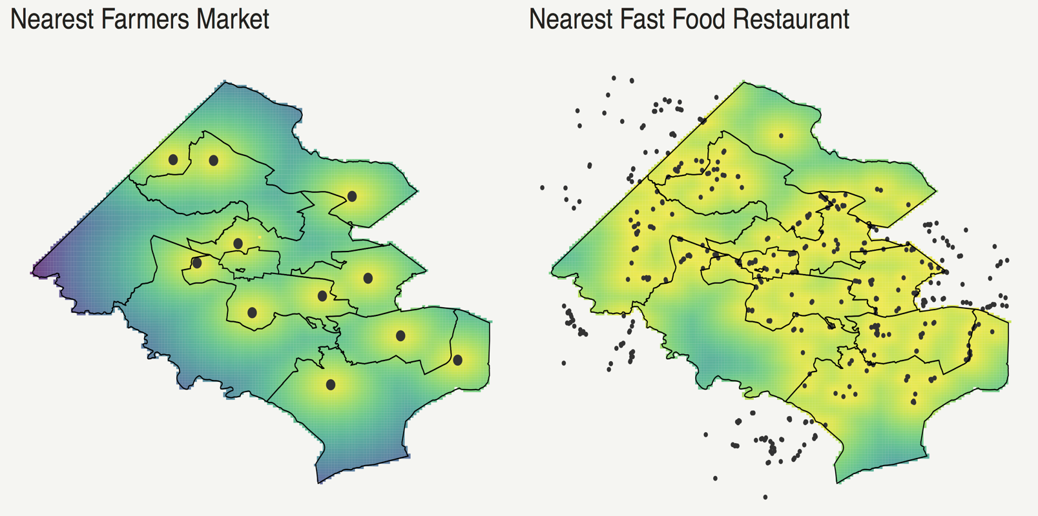
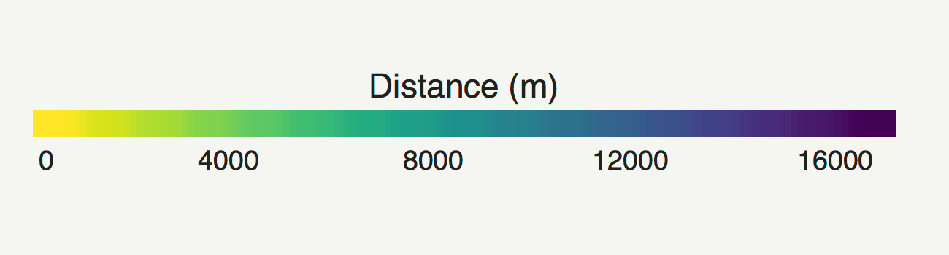
Distance to Healthy and Unhealthy Foods based on Location of Housing Units
Supervisor Districts in Fairfax County, Virginia

Slide 41
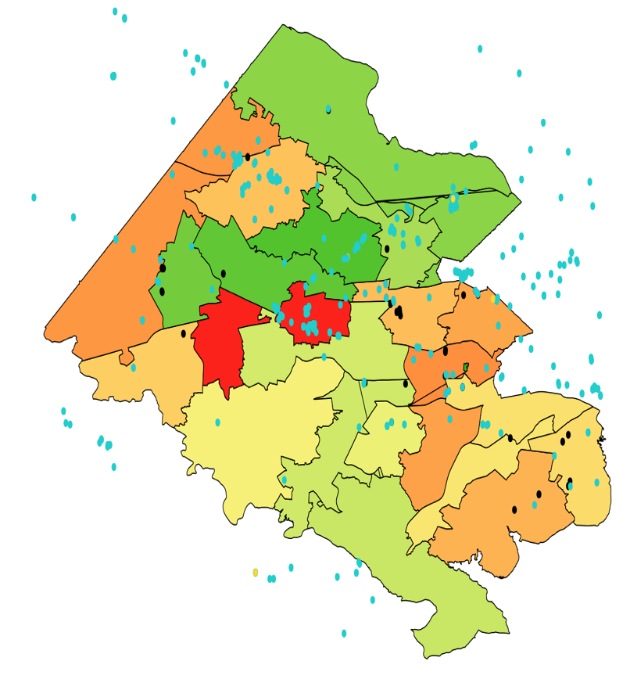
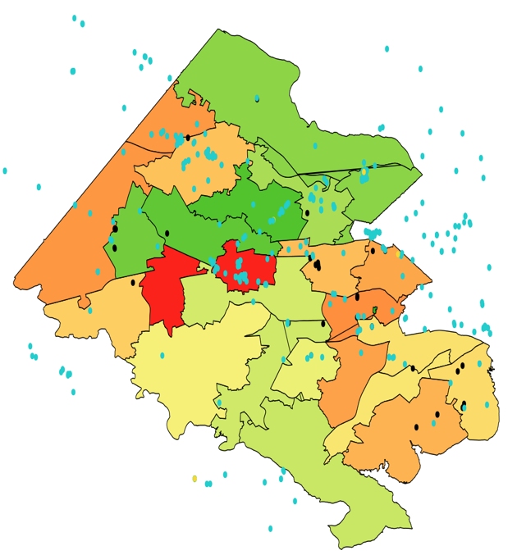
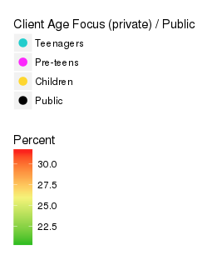
Students Reporting Depressive Symptoms and Location of Mental Health Providers
% of Students reporting depressive symptoms on youth survey –those who felt so sad or hopeless almost everyday for two weeks or more in a row during the past 12 months
Point are locations of Mental Health Providers – reported from Psychology Today and SAMHSA
Notes:
Public means Licensure/accreditation/approval to provide substance abuse treatment from the state substance abuse agency (SSA) or a national treatment accreditation organization.
https://findtreatment.samhsa.gov/locator/about
Client age focus:
Psychology today – scraped addresses, type of mental health provider, and description. https://www.psychologytoday.com/
Hierarchy of classification:\
If treats teens and others, classified as teens.
If treats preteens and others, but not teens, then classified as preteens
If treats children and others, but not teens, then classified as teens

Slide 42
Distance to Healthy and Unhealthy Foods based on Location of Housing Units
Supervisor Districts in Fairfax County, Virginia

Slide 43
Minutes per Week of Physical Activity by Grade, Gender, Race, and Ethnicity

Slide 44
Factors That Might Affect Obesity
Response Variable
1 | No Physical Activity
2 | 5+ Days of Physical Activity
3 | 5+ Servings of Fruit and Vegetables
4 | 1+sugary drink per day
5 | Unhealthy weight loss
6 | Food Insecurity
Fairfax Youth Survey, 2016-2017
Notes:
Scatterplots

Slide 45
Statistical Geographic Data Redistribution Data science innovations to develop sub-county data-driven insights
Synthetic population technology – Creating socioeconomic profiles of Supervisor Districts and High School Attendance Areas by statistically aligning American Community Survey data to these new geographic boundaries
Geocoding housing units, both owned and rented – based on tax assessment records and the reconstruction of rental units from files provided by Fairfax demographer
New sources of data – obtained from local administrative data and webscraping, with a focus on access to food and physical activity
Vulnerability Composite Indicators – integrating data
Exploring the data using visualization tools
Notes:
Synthetic Technology
Mapping distances to homes (owned and rented)
New sources of data
Economic Vulnerability Index
Visualization tools

Slide 46
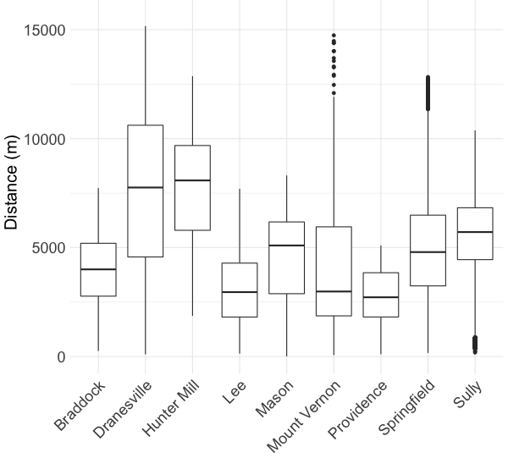
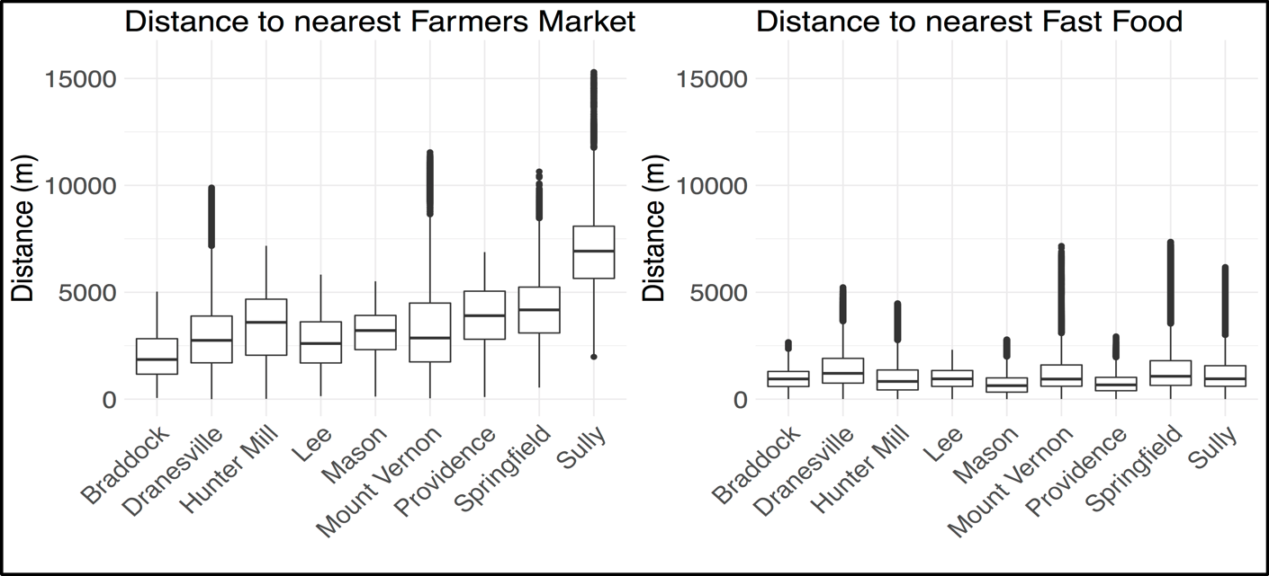
Direct aggregation based on location of housing units
Distance to nearest Recreation Center
Geocoding owner-occupied local housing stock
In general, adding rental units can be a challenge and may require imputation
Examples of place data:
All restaurants
Fast Food restaurants
Farmer’s Markets
Community Gardens
Recreation Centers
SNAP Retailers
Parks

Slide 47
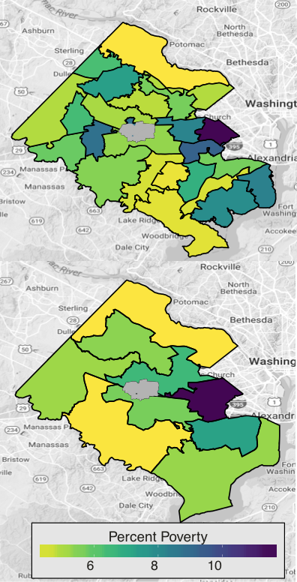
Re-distribution of data based on Synthetic Populations
Use American Community Survey (ACS) summaries and PUMS microdata to impute synthetic person data for all people in area of interest
Re-weight synthetic data according to ACS tables to simultaneously match the relevant distributions, to Census Tracts or Block Groups
Age, income, race, and poverty in this case
Aggregate synthetic person data to compute summaries, and margins of error, over the new geographic boundaries
Notes:
Figure 3. Fairfax County, Virginia demonstration of methodologies for redistributing data across relevant geographies. Source: Calculations and maps created by Virginia Tech, Social and Decision Analytics Laboratory, using American Community Survey data 2011-2015 aligned to new geographic boundaries using synthetic methods and data scraped from the website.

Slide 48
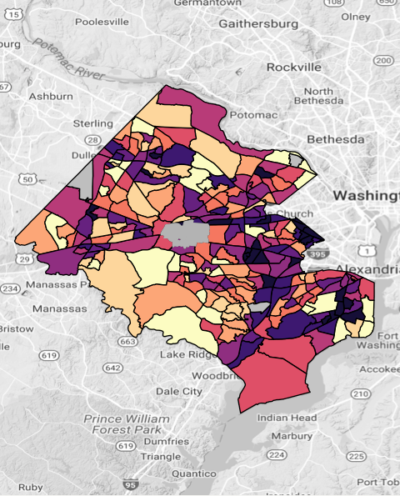
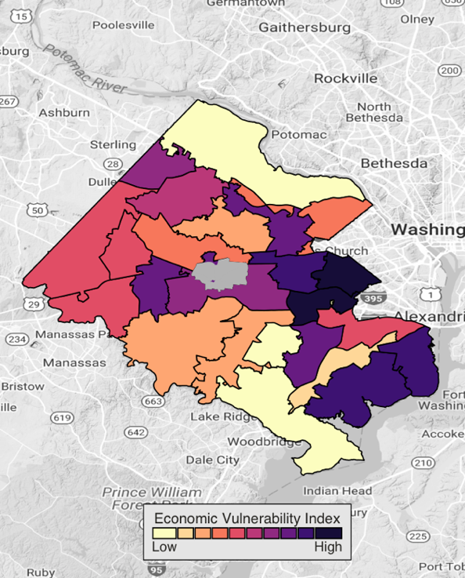
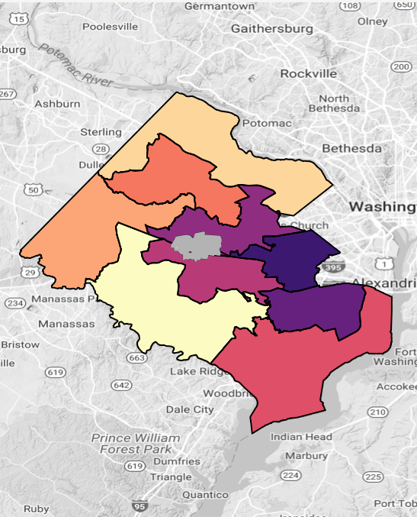
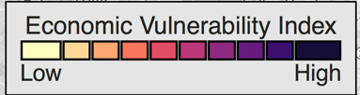
Sub-county Vulnerability Indicators
Census Tracts
High School Attendance Areas
Supervisor Districts
Based on a statistical combination of the percentage of Households with:
housing burdens > 50% of Household income
no vehicle
receiving Supplemental Nutrition Assistance Program (SNAP)
in poverty
Notes:
EVI was divided into deciles

Slide 49
Fairfax Profiles by Supervisor Districts Dashed lines = Average; Supervisor Districts arranged by Vulnerability Index from high to low
Source: American Community Survey 2011-2015 aligned to Supervisor Districts using SDAL Synthetic Technology.

Slide 50
Repurposing Administrative Data for Statistical Purposes National Academy of Sciences Workshop on Data Privacy for Employment Data, Jun 6 2017
Aaron D. Schroeder, Ph.D.
Senior Data Research Scientist
Social & Decision Analytics Lab
Biocomplexity Institute of Virginia Tech

Slide 51
Every Repurposing Is a New “Investigation”
Locating the Data Repurposing Discussion
Overview of the SDAD “Investigative Process” for Repurposing Data
Recommendations for Research-Enabling Standards for Integrated Administrative Data Systems to Aid Future Investigations

Slide 52
Data Repurposing Locating the Discussion
Secure/Privacy-Protecting Linkage
Distortion/Perturbation, Synthetic,
PUMS, SCIF
HIPPA
DFARS
HIPPA
FERPA
Dataset
Dataset
Dataset
Dataset
IDS
FISMA
State Law
Dataset
Dataset
Data Repurposing
Determining Data Fitness
?
Specific Question
DATA GOVERNANCE

Slide 53
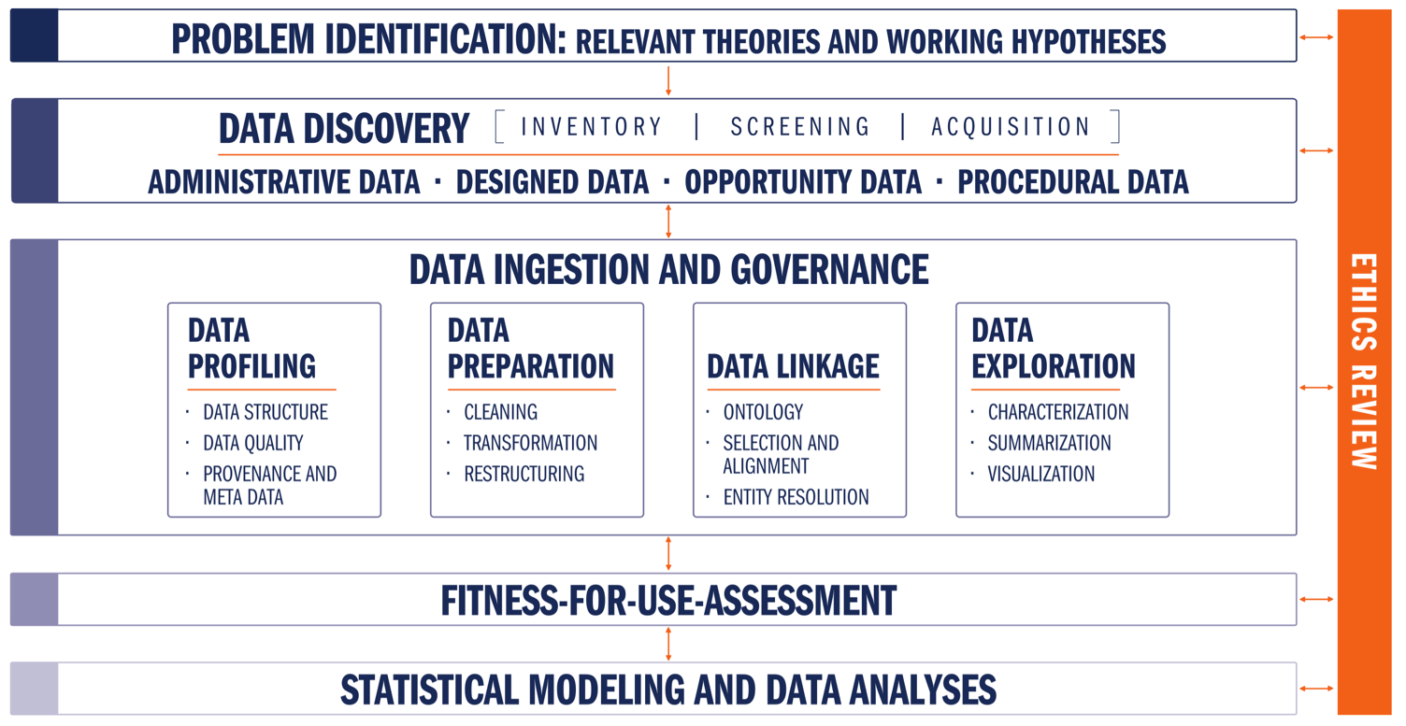
CLD3 - Data Science Processes for Evidence-Based Policy

Slide 54
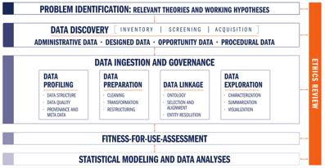
CLD3 - Data Science Processes & Platforms for Evidence-Based Policy
DETAIL

Slide 55
SDAL
Data Science Processes & Platforms
for Evidence-Based Policy
Data Analytics Process
Data Fitness Analysis
Data Analysis & Hypothesis Testing
Creation of Community Data Tools
Data Fitness Analysis
Profiling
Preparation
Linkage
Exploration & Assessment

Slide 56
Data Science Processes & Platforms for Evidence-Based Policy
Community Discovery Process
Facilitate preliminary problem identification & hypothesis generation starts with critical community-leader-defined issues and good contextual assessment
THIS SHOULD TAKE A LONG TIME
Biggest BANG for the BUCK for facilitated sessions is here
Conduct data management system status discovery to ascertain methods and technologies currently employed
Determine data storage and management capacity requirements of the entire process
Conduct data analytics capabilities assessment – are they going to use a statistical model you build? Or do they just need better counts?
Conduct data discovery and inventory process to identify potential data sources related to the specific issue areas
Deploy data connection technologies as required by an already established data access plan to enable the data transfer and management
TAKE THE TIME TO PERMIT FOCUS TO OCCUR
TAKE THE TIME TO PERMIT FOCUS TO OCCUR
TAKE THE TIME TO PERMIT FOCUS TO OCCUR

Slide 57
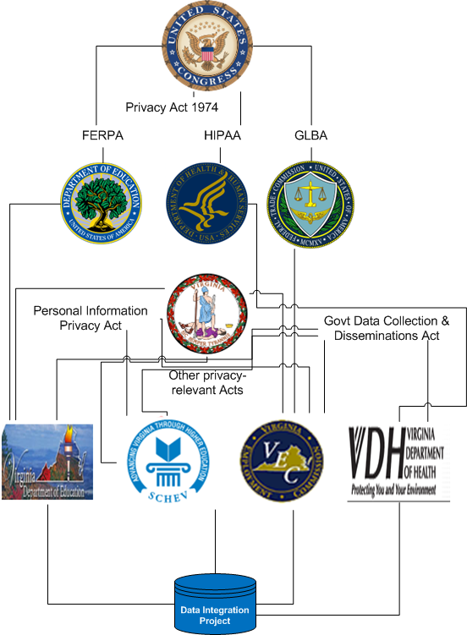
Data Science Processes for Evidence-Based Policy
Community Discovery Process
Situation Analysis & Hypothesis Generation: Context, Stakeholders, Joint-Visioning
Example: Implementation Environment of the Virginia Longitudinal Data System
Multiple levels of statutory law
Multiple implementations of regulatory law at each level of statutory law
Most conservative interpretation of regulatory law becomes de facto standard
“No one person , inside or outside a government agency, should be able to create a set of identified linked data records between partner agencies”
Has a direct and significant effect on the potential success of the technical approach chosen – A Centralized, Hierarchical Data Warehouse will likely Fail!
Easy to see, if you look for it!

Slide 58
Learn the Language! e.g. Virginia Towns

Slide 59
Data Discovery & Inventory
The first step preliminary inventory
identify which sources are worthy of a deeper screening
includes 6 questions and a qualitative evaluation of purpose, data collection method, timeliness, selectivity, accessibility, and description

Slide 60
Data Discovery & Inventory
Conducted on a selected subset from inventory
Much deeper dive
Output is a subset of data sets selected for acquisition and initial analysis of their fitness for analysis

Slide 61
Data Science Processes for Evidence-Based Policy
Data Management Process & Platform
Establish type and method of data transfer
pushed to or pulled into the cooperative platform?
staying where it is and being dynamically queried in a federated manner as needed?
Establish the best transfer protocol(s) to use given the types and method of transfer
e.g. SFTP, secure Dropbox, secured REST API, VT SAFR-Data Adapter for secure federated queries
Establish designed collection systems (e.g. behavioral experiments)
Establish data marshaling processes
system mediation logic, data pipeline and data transformation, transfer schedule, and data provenance maintenance
Establish secure data storage procedures
e.g. each project being stored on a new project-dedicated encrypted partition, original data being stored as non-removable and non-editable

Slide 62
Data Science Processes for Evidence-Based Policy
Data Information Process & Platform
The Lexicon: an inventory of and history of changes to:
every available data field in every available data source
the structure of their storage
possible values and meanings of the information
possible transformations of each set of field values from one data source to another another data source
methods of data source access
matching algorithms and how they are to be used in conjunction with possible field value transformations
Provides fundamental functions for the operation of the framework and is a requirement that the data information be collected from all partner communities
Enables removal of much complexity required for high quality data linkage
i.e. No enforcing data standardization schemes on data partners

Slide 63
Data Science Processes for Evidence-Based Policy
Data Information Process & Platform
Federated Data Linkage
Social Service Agency
Social Service Data
NewID
Gen
FIPS
SES
Data Adapter
7
F
51059
Med
Firewall
2
F
51059
Low
Ordered and Chaffed One-Way Hashes
9
M
51059
High
Education Data
Education Agency
Probabilistic Matching
NewID
Attend
ACT
SAT
7
.97
32
1580
2
.71
18
2110
9
.86
22
1360
Employment Data
NewID
Type
Length
perHr
7
0310
36
16.25
Employment Agency
2
0340
6
22.50
9
7800
21
13.75
Schroeder, A.D. (2012). Pad and Chaff: Secure Approximate String Matching in Private Record Linkage. Proceedings of the 14th International Conference on Information Integration and Web-based Applications and Services (iiWAS '12). pp. 121-125. DOI=10.1145/2428736.2428757. ACM, New York, NY, USA.
https://github.com/dads2busy/SAFRLink-DataAdapter
https://github.com/dads2busy/SAFRLink-Identity
https://github.com/dads2busy/SAFRLink-Crypto

Slide 64
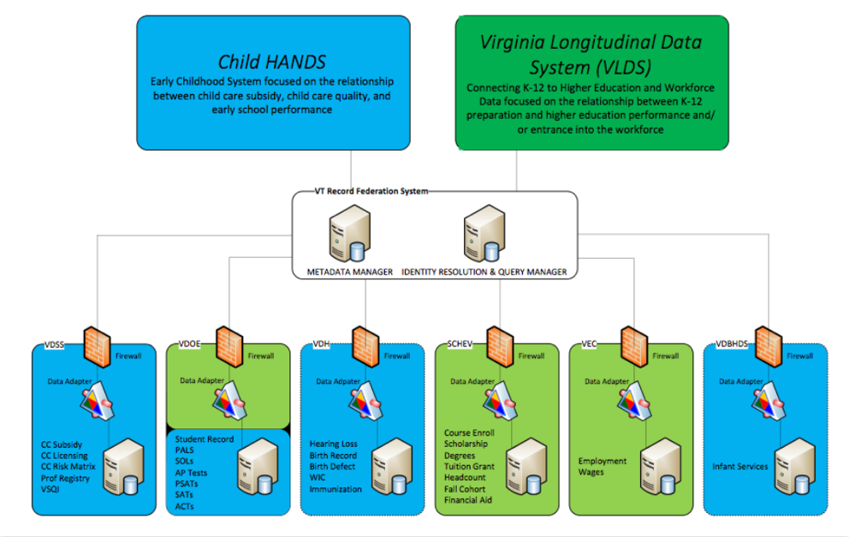
Data Science Processes for Evidence-Based Policy
Data Information Process & Platform
Federated Data Linkage
Schroeder, A.D. (2012). Pad and Chaff: Secure Approximate String Matching in Private Record Linkage. Proceedings of the 14th International Conference on Information Integration and Web-based Applications and Services (iiWAS '12). pp. 121-125. DOI=10.1145/2428736.2428757. ACM, New York, NY, USA.
https://github.com/dads2busy/SAFRLink-DataAdapter
https://github.com/dads2busy/SAFRLink-Identity
https://github.com/dads2busy/SAFRLink-Crypto

Slide 65
Data Science Processes for Evidence-Based Policy
Data Analytics Process
Data Fitness Analysis (Data Re-Purposing)
Modeling is a function of the research question (the use) – drives all data actions
Fitness assessment is about fitness of the data for the model
Fitness is a function of the model, data quality needs of the model, and data coverage (representativeness) needs of the model
When using multiple data sources, fitness will need to assess linking across data sources
Fitness must characterize information content in the results
Accuracy and precision

Slide 66
Data Science Processes for Evidence-Based Policy
Data Analytics Process
Data Fitness Analysis
Data Profiling
Structure
Quality
Provenance & Metadata
Data Preparation
Data Linkage
Data Exploration
Data Analysis & Hypothesis Testing
Creation of Community Data Tools

Slide 67
Repurposing Data for Statistical Purposes
Data Fitness Analysis: Profiling
Structure, Quality, Metadata & Provenance
Missing Variables
values in column headers instead of variable names
e.g. Value-ranges being used as column headers (0-9|10-19|20-29|…)
Combined Variables
more than one variable represented in a attribute (column) value
e.g. An attribute combining gender and age (m25, f32,...)
Multiple Observation Directions
variables in both columns and rows
e.g. A dataset with an element(column) for each day of the month (horizontal) and an element(column) for 'month' (vertical)
note. the messiest and can be dealt with multiple ways according to the needs of the specific analysis
Combined Observation Unit Types
more than one observation unit type per table
e.g. A table containing both individual demographic data and a periodic measurement like weekly attendance where demographic data and weekly attendance are separate observational units and need to be in separate datasets.
Divided Observation Unit Type
observation unit type is split among multiple tables
e.g. Individual demographic information split among several datasets; for example, separate tables for gender, ethnicity, and surname.

Slide 68
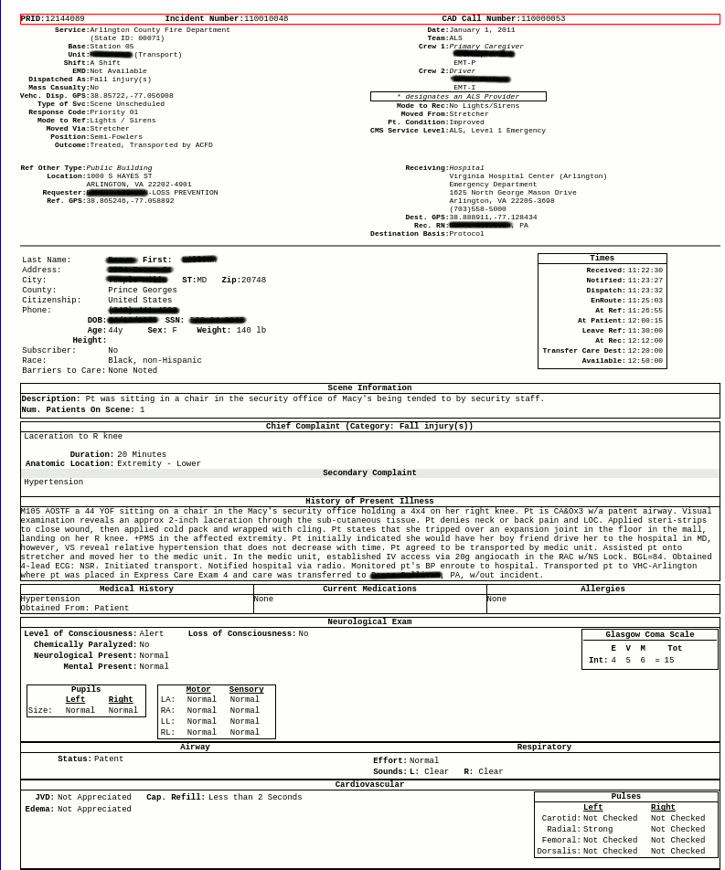

Repurposing Data for Statistical Purposes
Data Fitness Analysis: Profiling
Structure, Quality, Metadata & Provenance
Missing Variables
Emergency Services Data Processing Example
Values of a variables used for column headers

Slide 69
Repurposing Data for Statistical Purposes
Data Fitness Analysis: Profiling
Structure, Quality, Metadata & Provenance
Combined Observation Unit Types
Current Structure of Williamsburg MLS Data
List Number |  | Agency Name | Agency Phone | Agency Email | Listing Agent | Listing Agent Phone | Listing Agent Email | Co-Listing Agent | Property Type | Card Format
 | Book Section | Selling Agency | Selling Agency Phone | Selling Agency Email | Selling Agent | Selling Agent Phone | Selling Agent Email | Co-Selling Agent | End Date | book_sec
 | Listing Date | Sold Date | Under Cont. Date | Fall-thru Date | Status | Status Change | Withdraw Date | Cancel Date | Contingent | Cont. Remarks
 | Orig. List Price | Price | Sold Price | high_price | Low Price | assessed_val | Partial Tax Assmnt | financing | Area | Relocation
 | St. # | box_nbr | St. Dir. | Street Name | Address 2 | streetdirsuffix | Street Suffix | carrier_route | City | State
 | county | country | Zip Code | geo_county | Taxes | geo_lat | geo_lon | Est. Fin. SqFt | sqft1 | sqft2
 | sqft3 | sqft4 | Year Built | 2+ Bdroms on 1st Flr | Realtor.com Type | lot_size | Total Acres | Condo Level | sell_broker_comm | Variable Commission
 | stories | Total Rooms | Total Bedrooms | total_bath | Baths - Full | Baths - Half | baths_3_4 | Garage Type | garage_stall | Water Frontage
 | Zoning | taxes | Tax Year | Subdivision | Public Remarks | Agent Remarks | Parcel ID | Legal Description | Directions | Foreclosure
 | Owner Phone | Owner Name | Neighborhood | mod_timestamp | Ltd Service Agent | Occupied By | Owner/Agent | Mster Bdrm 1st Floor | SqFt Source | Listing Type
 | # Stories | # Fireplaces | Golf Frontage | IDX Y/N | Supplement Attached | Seller Concession(s) | Special Assmnts | Type | Rollback Taxes | userdefined16
 | SellingBroker Incent | Ownership | Describe Concession | How Sold | Selling Broker Comp | userdefined22 | Assessed Value | Est.Unfinished Sq Ft | Tax Rate | Garage Bays
 | userdefined27 | userdefined28 | userdefined29 | userdefined30 | Est. Closing Date | userdefined32 | userdefined33 | Lot Description | Short/CompromiseSale | userdefined36
 | userdefined37 | userdefined38 | userdefined39 | userdefined40 | userdefined41 | userdefined42 | userdefined43 | userdefined44 | userdefined45 | userdefined46
 | userdefined47 | userdefined48 | userdefined49 | userdefined50 | userdefined51 | userdefined52 | userdefined53 | userdefined54 | userdefined55 | userdefined56
 | Photo URL | Days on Market | Rooms | Features
This is a single record with 128 fields all keyed to the variable “List Number”
Structured this way, it is not possible to analyze property changes over time
Pulling out a definitive list of unique properties using “Parcel ID” seems like a possibility
However, “Parcel ID” is left blank in over 7% of entries – extra work required – perhaps including address, but address is not standardized

Slide 70
Repurposing Data for Statistical Purposes
Data Fitness Analysis: Profiling
Structure, Quality, Metadata & Provenance
Combined Observation Unit Types
Ideal Restructuring of MLS Data
Property Characteristics
∞
Property ID
&
Location
Property Sales Information
1
∞
Property Tax Information
∞

Slide 71
Repurposing Data for Statistical Purposes
Data Fitness Analysis: Profiling
Structure, Quality, Metadata & Provenance
Combined Observation Unit Types
Unit Information
Emergency Services Data Processing Example
Scene Information
Multiple Types of Observation on Single Page
Additionally:
Forms made available online as nested HTML Tables - each needing separate extraction
Neurological Information

Slide 72
Repurposing Data for Statistical Purposes
Data Fitness Analysis: Profiling
Structure, Quality, Metadata & Provenance
Divided Observation Unit Types
gender1 id gender2
F 43XXX13 M
F 43XXX14 M
M 76XXX46 F
F 74XXX98 M
F 76XXX23 M
F 77XXX40 M
M 74XXX98 F
M 78XXX73 F
F 78XXX74 M
M 77XXX84 F
F 79XXX87 M
M 71XXX95 F
M 21XXX96 F
M 71XXX54 F
F 71XXX55 M
F 77XXX86 M
F 80XXX24 M
M 76XXX79 F
NC Student Data
Demographics Recorded in Multiple Tables
Actual 2011 data from different tables linked via unique ID
Many more tables with apparently separately collected demographics
Derivation of Demographic Truth is now Probabilistic

Slide 73
Repurposing Data for Statistical Purposes
Data Fitness Analysis: Profiling
Structure, Quality, Metadata & Provenance
Completeness
percentage of elements properly populated
e.g. Testing for NULLs and empty strings where not appropriate
Value Validity
percentage of elements whose attributes possess meaningful values
e.g. A comparison constraint like {male; female} or an interval constraint like age = [0,110]
Consistency
a measure of the degree to which two or more data attributes satisfy a well-defined dependency constraint – relationship validation
e.g. Zip-code – state consistency or gender – pregnancy consistency
Uniqueness
the number of unique values taken by an attribute, or a combination of attributes in a dataset
e.g. Frequency distribution of an element
note. The more homogeneous the data values of an element, the less useful the element is for analysis
Duplication
a measure of the degree of replication of distinct observations per observation unit type
e.g. Greater than 1 registration per student per official reporting period
note. Duplication occurs as a result of choice of level of aggregation

Slide 74
Repurposing Data for Statistical Purposes
Data Fitness Analysis: Profiling
Structure, Quality, Metadata & Provenance
Completeness
Seems straight-forward -- Nope
A set of data is complete with respect to a given purpose if the set contains all the relevant data for that purpose
A common measure is the proportion of data that has values to the proportion that “should” have values.
Completeness is application-specific
Incorrect to simply measure number of missing field values in a record without considering which fields are necessary
MLS Data had MANY highly incomplete fields that were not necessary for the study at hand
Data that are missing can be categorized as:
record fields not containing data
records not containing necessary fields
datasets not containing the requisite records

Slide 75
Repurposing Data for Statistical Purposes
Data Fitness Analysis: Profiling
Structure, Quality, Metadata & Provenance
Value Validity
Data elements with proper values have value validity
The percentage of data elements whose attributes possess values within the range expected for a legitimate entry is a measure of value validity
Checking for value validity generally comes in the form of straight-forward domain constraint rules
How many entries contain non-valid values for a non-empty text field representing gender?
< count gender where gender is not (male, female) >
How many entries contain non-valid values for a non-empty integer field representing age?
< count age where age is not between [0, 110] >

Slide 76
Repurposing Data for Statistical Purposes
Data Fitness Analysis: Profiling
Structure, Quality, Metadata & Provenance
Value Validity
Pulled from current James City County MLS Data
zip_code | area | subdivision | neighborhood | zoning | parcel_id
23185 | JCC | Governors Land | River Reach | R-4 | 4511000022
23188 | JCC | Wellington |  | RESIDENT | 1330800178
23188 | JCC | Powhatan Secondary |  | RES | 3741600013
23185 | JCC | Kingsmill | Padgetts Ordinary | R 4 | 5041100213
23185 | JCC | Pointe @ Jamestown |  | RES | 4640600108
23185 | JCC | Paddock Green | Paddock Green | R1
Comparison constraint: zoning 2015, James City County = {A-1, R-1, R-2, R-3, R-4, R-5, R-6, R-7, R-8, LB, B-1, M-1, M-2, RT, PUD, MU, PL, EO}
During Data Profiling issues are described, not “fixed”
The appropriate fix depends upon the needs of the research
It may be appropriate to simply normalize all zoning entries to the five major categories of zoning: Residential, Mixed Residential-Commercial, Commercial, Industrial, and Special

Slide 77
Repurposing Data for Statistical Purposes
Data Fitness Analysis: Profiling
Structure, Quality, Metadata & Provenance
Consistency
The Degree to Which Two or More Attributes Satisfy a Dependency Constraint
Simple example
Location disagreements like zip and state (Record-Level)
More complex example (Longitudinal)
Consistency with locally derived “truth”
VDOE Student Record, no definitive list of student demographics
Truth must be derived from multiple observations
Student Record has multiple observations per school year
Query here shows disagreement on gender for some of the observations when Student Record is matched to itself
select count(distinct a.internal_id) from vdoe.student_record a join vdoe.student_record b on a.internal_id = b.internal_id and a.gender <> b.gender
16,310 / 2,346,058 individuals have more than one value for gender

Slide 78
Repurposing Data for Statistical Purposes
Data Fitness Analysis: Profiling
Structure, Quality, Metadata & Provenance
Record Consistency
Emergency Services Data Processing Example
Consistency Issue:
Violates time dependency constraint
Leaves scene before arriving

Slide 79
Repurposing Data for Statistical Purposes
Data Fitness Analysis: Profiling
Structure, Quality, Metadata & Provenance
Observation Unit Definition
Datasets (tables) without definition and/or non-meaningful/confusing naming
Observation Unit Attributes Definition
Attributes (columns) without definition and/or non-meaningful/confusing naming
Semantic Confusion
Attributes with the same name but different definitions
e.g. An attribute named “Grade” can refer to both a 'score' for a test or the 'level/year’
Multiple Attribute Names
Attributes with different names but the same definition
e.g. Attributes name “Grade” and “Year” both referring to 'level/year' of schooling
Inconsistent Attribute Formats
Attributes of the same type that are formatted differently
e.g. Most commonly an issue when dealing with dates and times
Data Process History
Attributes collected at different locations, with different tools
System of Origin
Where was this data originally collected?
Intermediate Storage Systems
Chain of Custody
Contact Information
Who can I contact with my questions?
Transformation
What happened to the data since collection and why?
Getting this stuff in order is a BIG part of Data Repurposing!

Slide 80
Repurposing Data for Statistical Purposes
Data Fitness Analysis: Profiling
Structure, Quality, Metadata & Provenance
Observation Unit Attributes Definition
Emergency Services Data Processing Example
Metadata needed:
Time definitions unclear

Slide 81
Repurposing Data for Statistical Purposes
Data Fitness Analysis: Profiling
Structure, Quality, Metadata & Provenance
Unit Information
Emergency Services Data Processing Example
(Quality) Consistency Issue:
Violates time dependency constraint
Leaves scene before arriving
Scene Information
(Metadata) Metadata needed:
Time definitions unclear
(Structure) Multiple Types of Observation on Single Page
Additionally:
(Structure) Forms made available online as nested HTML Tables - each needing separate extraction
Neurological Information

Slide 82
Emergency Services Data Processing Example
Unit Information
Metadata needed:
Time definitions unclear
Inconsistent Values:
Violates time dependency constraint
Scene Information
Multiple Types in one table (of tables) that need separation
Format Issue:
Values of a variable used for column headers
Neurological Information
Format Issue:
Forms made available online as nested HTML Tables - each needing separate extraction

Slide 83

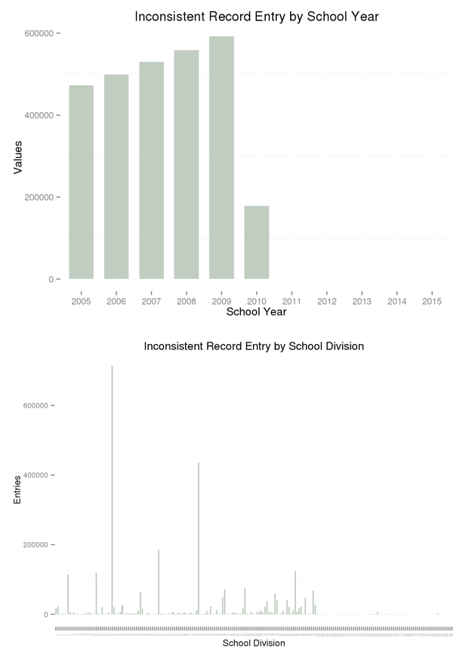
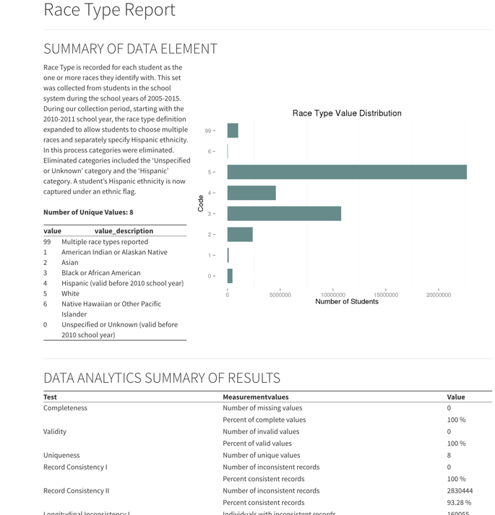
Example: Consistency Quality Analysis can only be Semi-Automated

Slide 84
Data Science Processes for Evidence-Based Policy
Data Analytics Process
Data Fitness Analysis
Data Preparation
The Data Preparation Phase includes the activities necessary to “fix” the issues of Quality, Structure, and Metadata discovered during Data Profiling – activities can include:
Cleansing
Missing Values
Date Formats
Nominal => numeric
Outliers
Inconsistent Data
De-duplication
Transformation
Aggregation
Normalization
Smoothing
Winsorization
Feature Construction
Restructuring

Slide 85

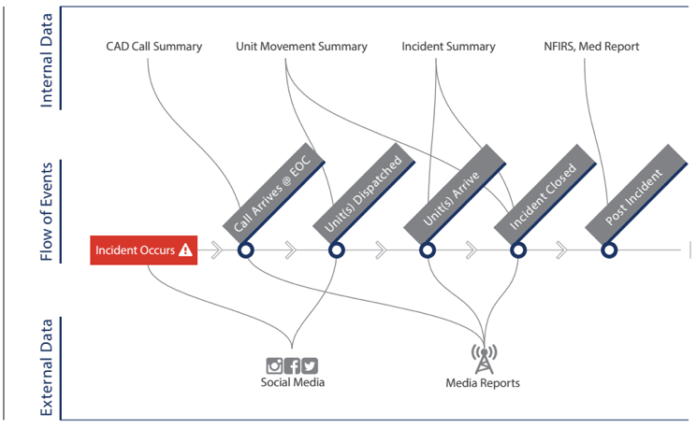
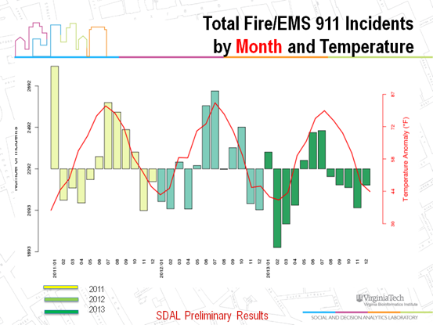
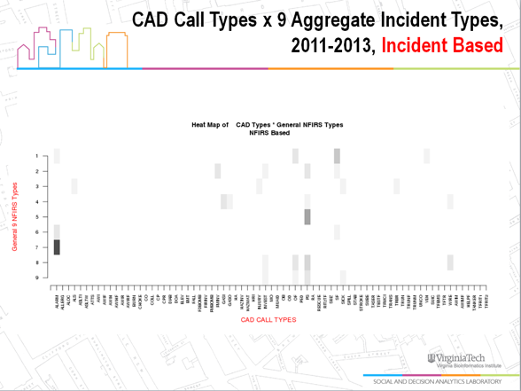

Data Science Processes & Platforms for Evidence-Based Policy
Data Analytics Process
Data Fitness Analysis
Data Analysis & Hypothesis Testing

Slide 86


Data Science Processes & Platforms for Evidence-Based Policy
Data Presentation Process

Slide 87
CLD3 - Data Science Processes & Platforms for Evidence-Based Policy
DETAIL

Slide 88
Research-Enabling Standards for Integrated Administrative Data Systems
Metadata
Minimum: Table and Field Definitions, Field Valid Values and Definitions
Extra: Valid Value Timing and Relationship Data
Provenance
Minimum: System of Origin/Collection and Contact
Extra: Intermediate Storage Systems and Contacts
Extra +: Transformations Used and Reasons Why
Just starting with the Minimums will accomplish quite a bit

Slide 89

What can we do in a few hours that might be useful?
Ingestion, Profiling and Transformation is BIGGEST part of policy oriented data science
Try and hit a small sample of each stage using R and PostGIS
Walk through ingesting and transforming geographic and administrative data to create an index or two that might be useful for policy making
Maybe some tips. Read-Combine?

Slide 90

CNT’s Gravity Model of Employment Access

